Slide 1

Airways Transport Network
By…
Likhil (lkr46)
Vuthej (vv334)

Slide 2
Overview
Dataset Source (Bureau of Transportation Statistics)
Focus on US Domestic Airport Network
Centrality Measures
Community Detection
CNM Greedy Modularity
Girvan-Newman
Results and Discussion

Slide 3

Objective
Problem Can all airports be resumed simultaneously?
To identify robust networks with influential airports.
Efficient revival post COVID
(to attain maximum connectivity through minimal airports)

Slide 4
Data Overview
UNIQUE_CARRIER_NAME | ORIGIN_AIRPORT_ID | ORIGIN | DEST_AIRPORT_ID | DEST | MONTH
Empire Airlines Inc. | 10140 | ABQ | 11413 | DRO | 3
Empire Airlines Inc. | 10140 | ABQ | 11711 | FMN | 3
Empire Airlines Inc. | 10194 | AFW | 12278 | ICT | 3
Empire Airlines Inc. | 10194 | AFW | 12896 | LBB | 3
Empire Airlines Inc. | 10194 | AFW | 13158 | MAF | 3
Empire Airlines Inc. | 10194 | AFW | 15370 | TUL | 3
Empire Airlines Inc. | 10299 | ANC | 10299 | ANC | 3
Empire Airlines Inc. | 10299 | ANC | 11555 | ENA | 3
Empire Airlines Inc. | 10299 | ANC | 11630 | FAI | 3
Empire Airlines Inc. | 10299 | ANC | 12184 | HOM | 3
Empire Airlines Inc. | 10666 | BLI | 11762 | FRD | 3
Empire Airlines Inc. | 10666 | BLI | 14747 | SEA | 3
Empire Airlines Inc. | 11050 | CLM | 14747 | SEA | 3
Empire Airlines Inc. | 11198 | CVO | 14057 | PDX | 3
CSV Format Data
1946 Nodes
263846 Connections
Bidirectional Network

Slide 5
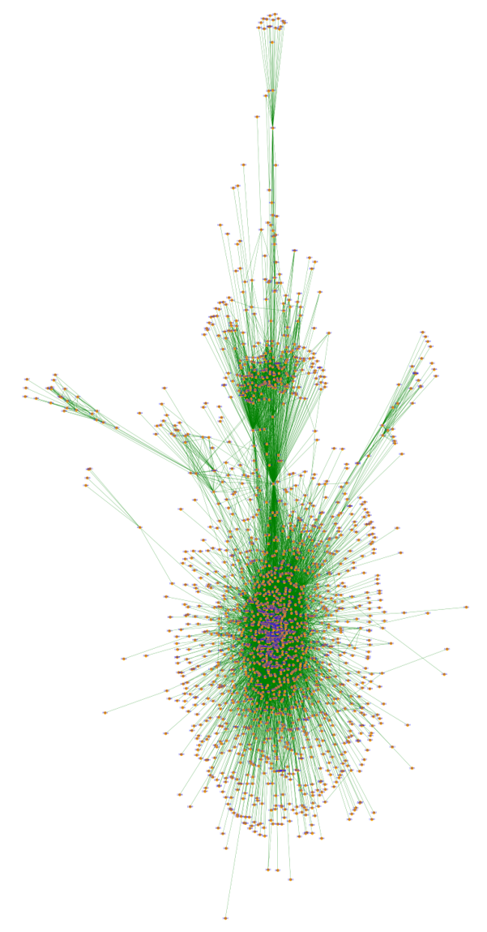
Visualization of data..
Tools Used
Networkx
Gephi

Slide 6
Centrality as Measure..
Degree Centrality
ORD – 0.34841
Closeness Centrality
ORD – 0.45658
Betweenness Centrality
ANC – 0.18889
Eigenvector Centrality
ORD – 0.12884

Slide 7
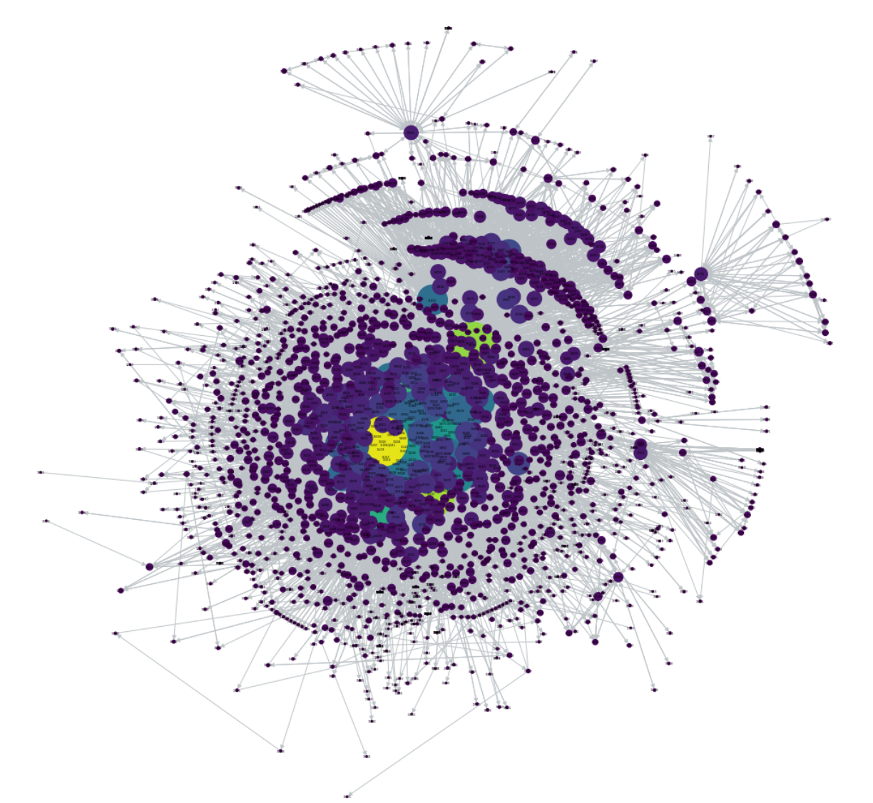
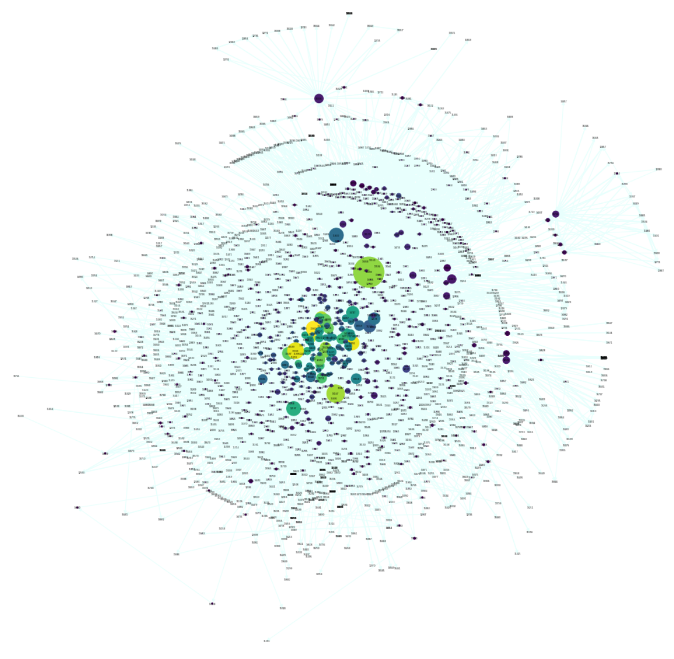
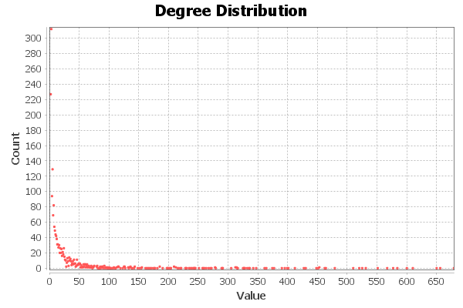
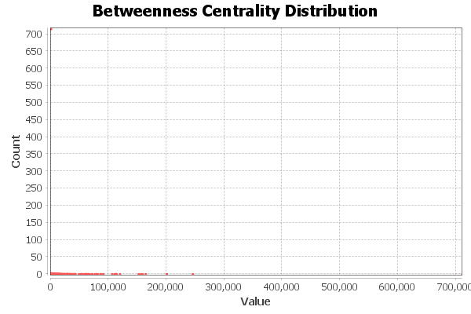
Degree Centrality
Betweenness Centrality

Slide 8
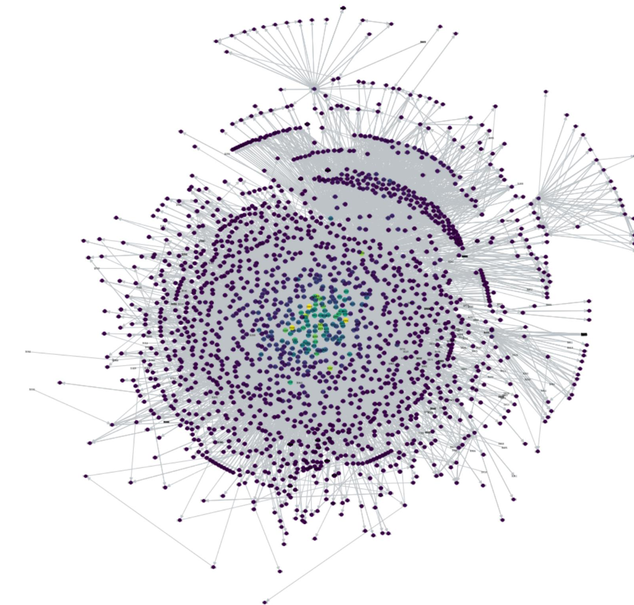
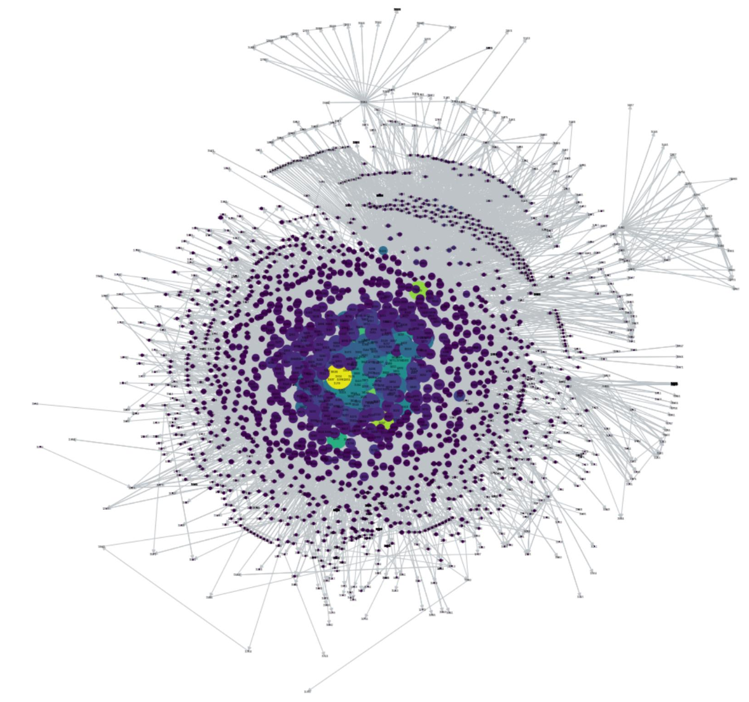
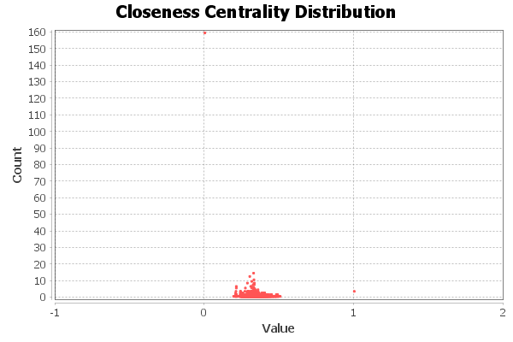
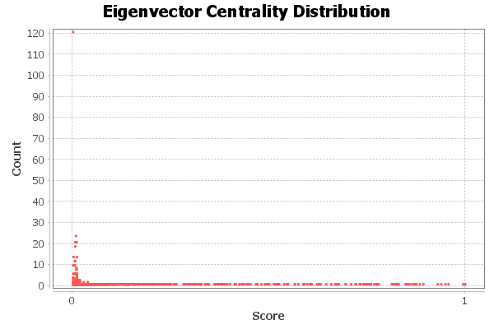
Closeness Centrality
Eigenvector Centrality

Slide 9

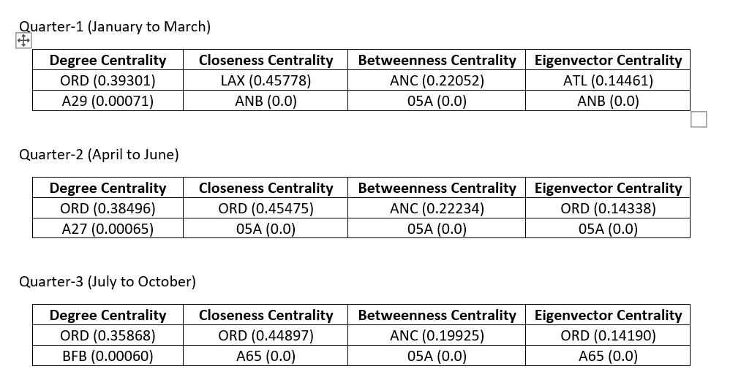
Quarterly Stats

Slide 10
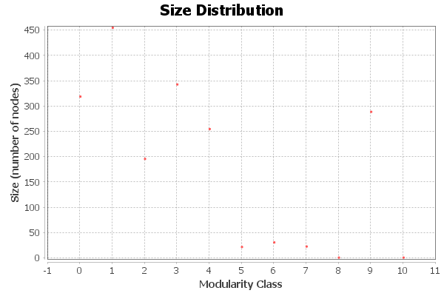
Methodology
Clauset Newman Moore Greedy Modularity
Based on Modularity
Communities Identified : 16
Modularity : 0.319
Time Consumed : 50.843 seconds

Slide 11
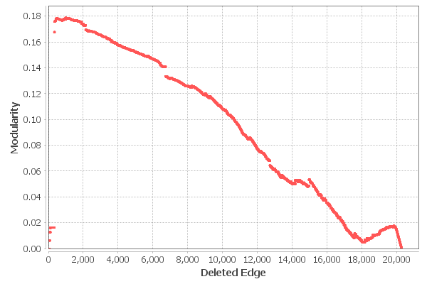
Methodology
Girvan-Newman
Based on Betweenness
Iterative removal of edges
Modularity : 0.179
Time Consumed : 15910.776 seconds

Slide 12
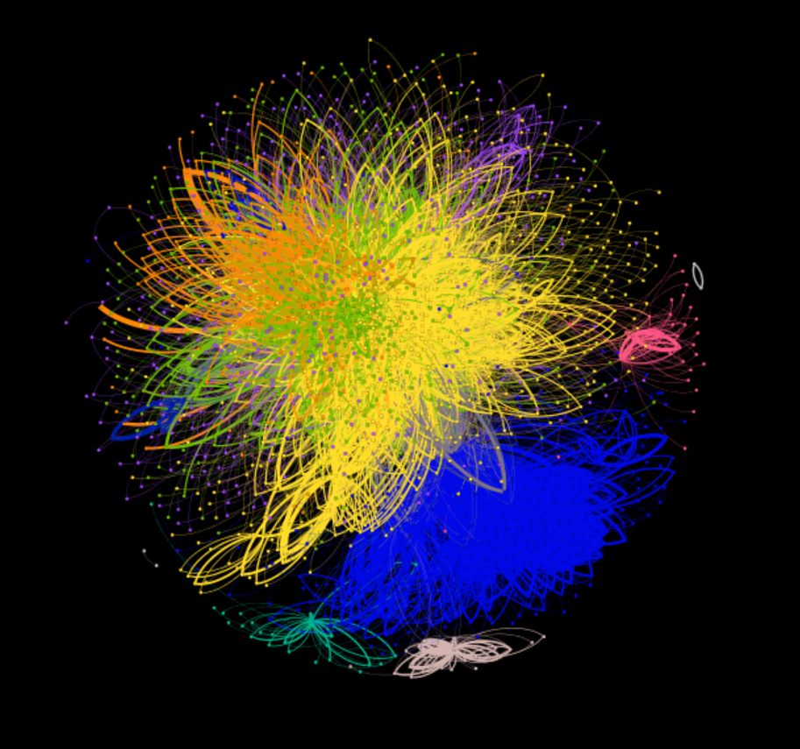
Greedy Modularity Community Visualization

Slide 13
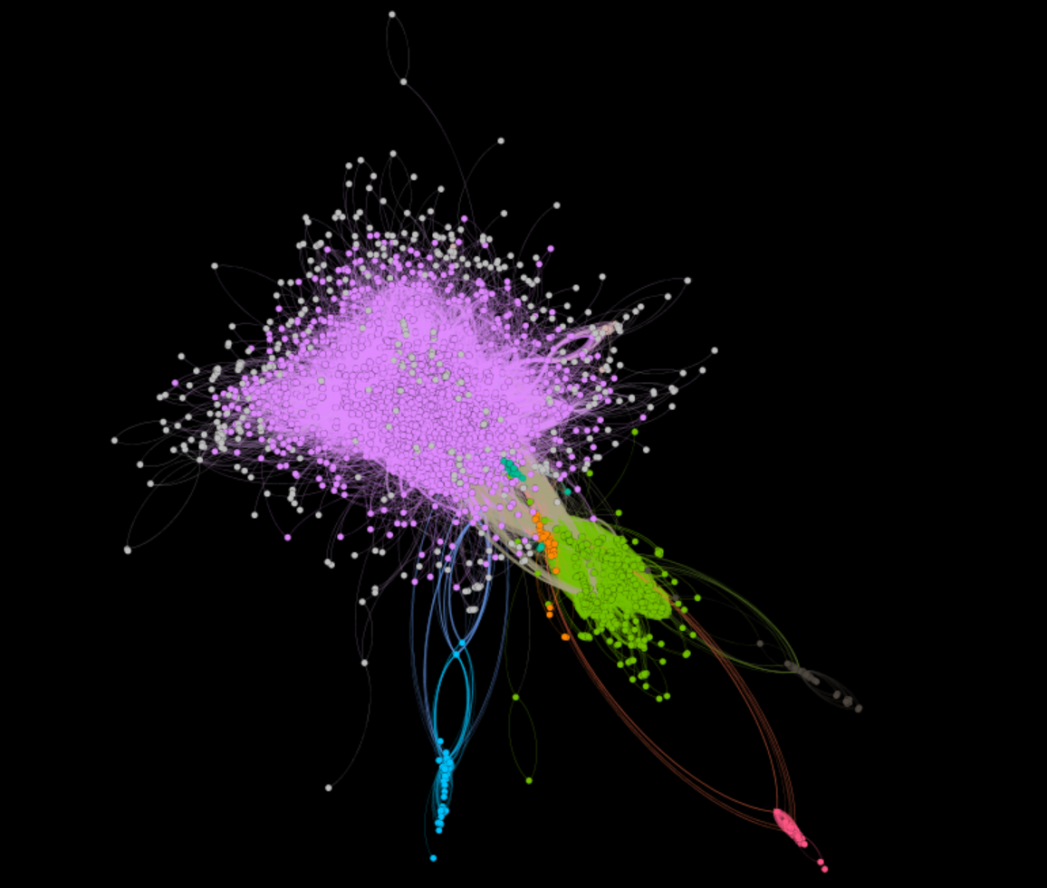
Girvan-Newman Community Visualization

Slide 14
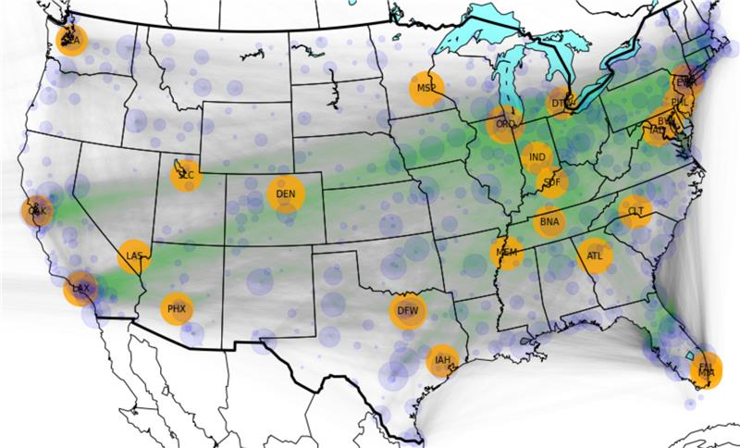
Influential Airports in Communities

Slide 15

Results
Community No. | Airport ID | Influential Airport Name
1 | JFK | John F. Kennedy International Airport
2 | DFW | Dallas Fort Worth International Airport
3 | ANC | Ted Stevens Anchorage International Airport
4 | ORD | O’Hare International Airport
5 | SFO | San Francisco International Airport
6 | ATL | Hartsfield-Jackson Atlanta International Airport
7 | BLD | Bradley International Airport
8 | SMO | Santa Monica Airport
9 | LAX | Los Angeles International Airport
10 | DEN | Denver International Airport
11 | LAL | Lakeland Linder International Airport
12 | SEA | Seattle-Tacoma International Airport
13 | MIA | Miami International Airport
14 | EWR | Newark Liberty International Airport
15 | HNL | Daniel K. Inouye International Airport
16 | PAE | Paine Field Airport

Slide 16
Conclusion..
Robust Communities are identified.
Influential Airports from different communities.
Post COVID revival.

Slide 17
Future Work
Analysis can be scaled to different countries.
Inclusion of Airlines into Airports network analysis.

Slide 18
Thank You!

